Slide 1


DATA 225 Database Systems for Analytics August 28 Class Meeting
Department of Applied Data Science San Jose State University Fall 2023 Instructor: Ron Mak
www.cs.sjsu.edu/~mak

Slide 2
This Evening
SQL, Python, and MySQL Workbench skills
connect to a database
fetch and insert records
query results in a dataframe
dynamic query generation
create a table
extract, transform, and load (ETL) CSV data
export/import (dump/restore) a database
create a user
mysql command
Break

Slide 3
This Evening, cont’d
Introduction to database design
database systems and client-server architecture
development steps
requirements
entity-relationship (ER) diagrams
conceptual database model
logical database model
physical database model
one-to-one, one-to-many, many-to-many relationships

Slide 4
Today’s Notebooks and Files
Connect to a database
Fetch records from a database
01-School.ipynb
school.ini
school-remote.ini
02-FetchAll.ipynb
03-FetchOne.ipynb
04-FetchMany.ipynb

Slide 5
Today’s Notebooks and Files, cont’d
Query results and Pandas dataframes
Dynamically generated query string
Create a database table
05-MabelFlynnStudents-df.ipynb
06-StudentsOf.ipynb
07-CreateTable.ipynb

Slide 6
Today’s Notebooks and Files, cont’d
Insert rows into a table
CSV files
08-Insert.ipynb
09-Insert-tuple.ipynb
10-Insert-dictionary.ipynb
11-CSV-read.ipynb
12-CSV-insert.ipynb

Slide 7
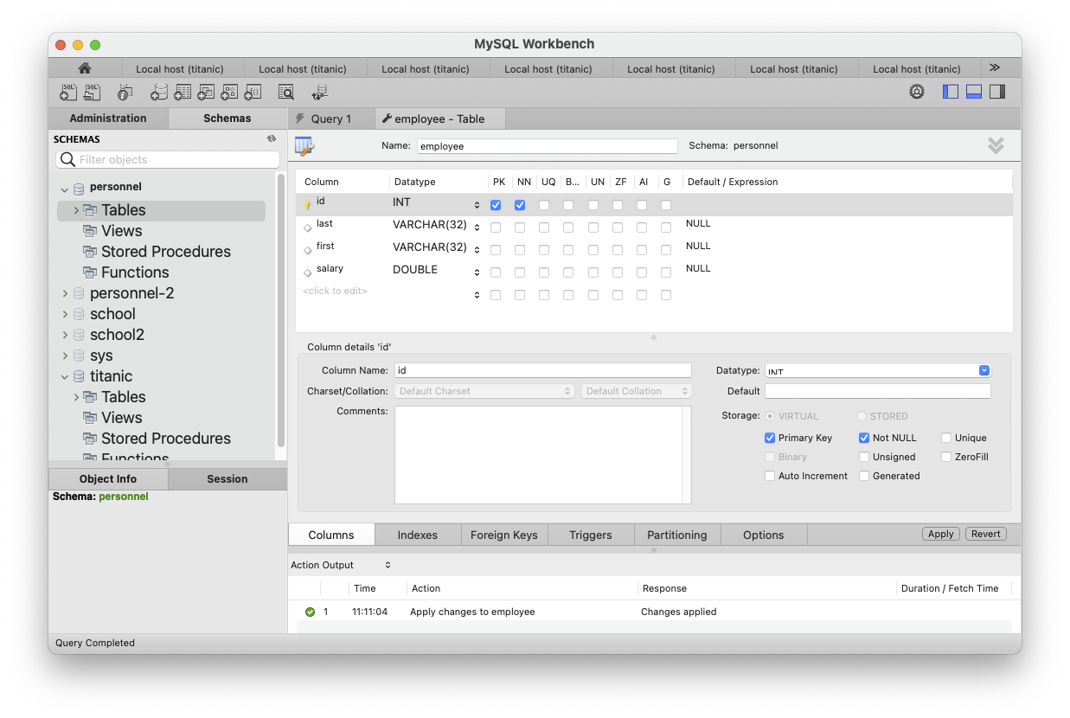
Create Table with MySQL Workbench
You can use MySQL Workbench to create a new database (schema) and a table.
Make sure personnel
is the current schema.
Then right-click Tables
and select "Create Table ..."
PK: primary key
NN: non-null

Slide 8
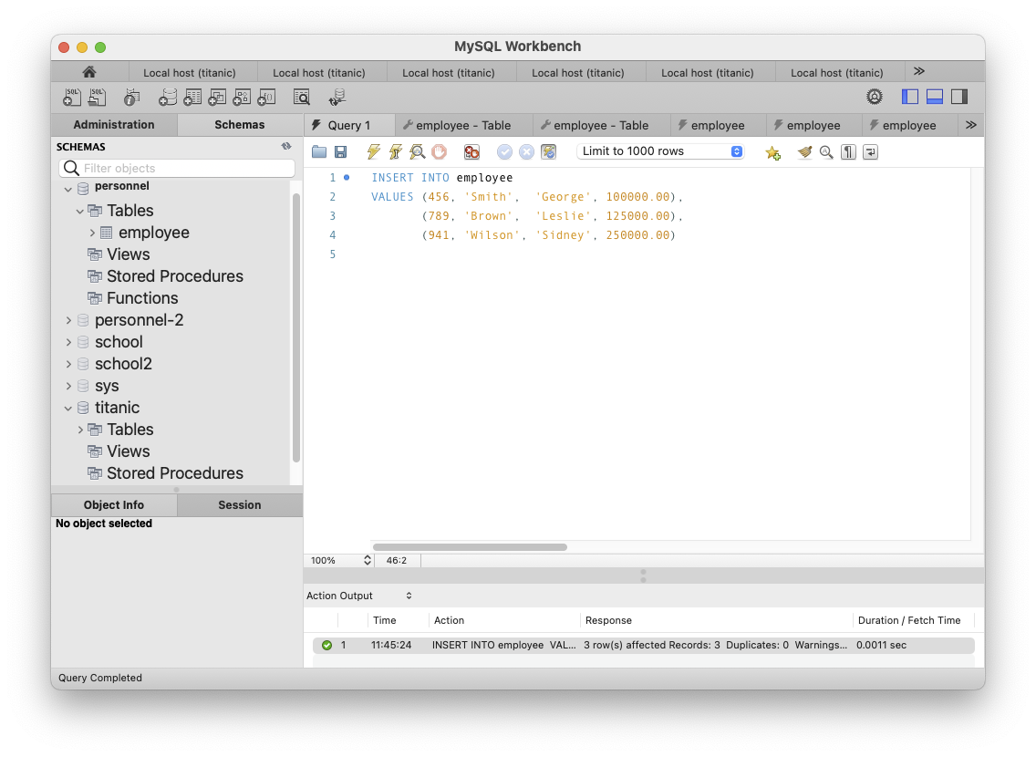
Insert Rows with MySQL Workbench
INSERT INTO employee
VALUES (456, 'Smith', 'George', 100000.00),
(789, 'Brown', 'Leslie', 125000.00),
(941, 'Wilson', 'Sidney', 250000.00)

Slide 9
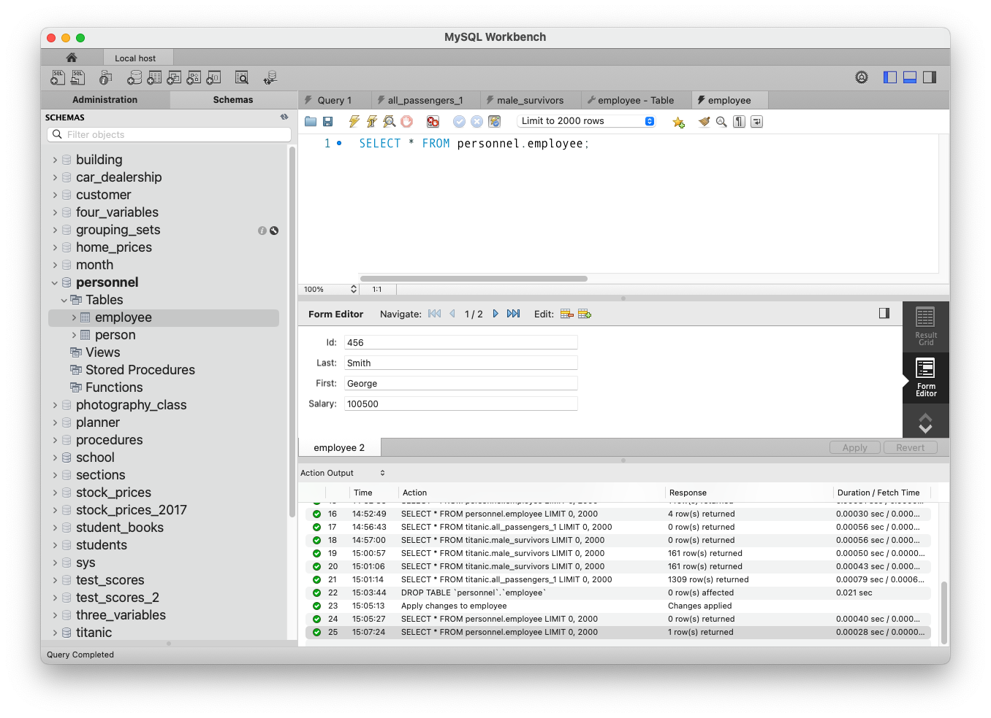
Insert Rows with MySQL Workbench, cont’d

Slide 10
CSV Files
Text files containing comma-separated values (CSV) are a popular format to download data.
A textbook example is TitanicSurvival.csv
"","survived","sex","age","passengerClass"
"Allen, Miss. Elisabeth Walton","yes","female",29,"1st"
"Allison, Master. Hudson Trevor","yes","male",0.916700006,"1st"
"Allison, Miss. Helen Loraine","no","female",2,"1st"
"Allison, Mr. Hudson Joshua Crei","no","male",30,"1st"
"Allison, Mrs. Hudson J C (Bessi","no","female",25,"1st"
"Anderson, Mr. Harry","yes","male",48,"1st"
"Andrews, Miss. Kornelia Theodos","yes","female",63,"1st"
"Andrews, Mr. Thomas Jr","no","male",39,"1st"
"Appleton, Mrs. Edward Dale (Cha","yes","female",53,"1st"
"Artagaveytia, Mr. Ramon","no","male",71,"1st"
"Astor, Col. John Jacob","no","male",47,"1st"
"Astor, Mrs. John Jacob (Madelei","yes","female",18,"1st"
"Aubart, Mme. Leontine Pauline","yes","female",24,"1st"
"Barber, Miss. Ellen Nellie","yes","female",26,"1st"
"Barkworth, Mr. Algernon Henry W","yes","male",80,"1st"
"Baumann, Mr. John D","no","male",NA,"1st"
"Baxter, Mr. Quigg Edmond","no","male",24,"1st"
...

Slide 11
Extract, Transform, and Load CSV Data
There are multiple ways to ETL a CSV file.
ETL: extract, transform, load
We may want to clean the data:
Replace the passenger classes "1st", "2nd", and "3rd" with integers 1, 2, and 3, respectively.
Replace each "NA" for a missing age with 0.
"Yousif, Mr. Wazli","no","male",NA,"3rd"
"Yousseff, Mr. Gerious","no","male",NA,"3rd"
"Zabour, Miss. Hileni","no","female",14.5,"3rd"
"Zabour, Miss. Thamine","no","female",NA,"3rd"

Slide 12
Three Ways to ETL a CSV File
Use Python + SQL code.
Python code reads and transforms the CSV data.
SQL code embedded in the Python code inserts the transformed code into the database tables.
A very flexible way to do ETL.
Execute SQL’s LOAD DATA command.
Less control over data transformations.
Load only one table at a time.
MySQL Workbench’s Table Data Import Wizard.
Simplest but least flexible.

Slide 13
Today’s Notebooks and Files, cont’d
CSV files
ETL CSV Data #1
11-CSV-read.ipynb
12-CSV-ETL.ipynb

Slide 14
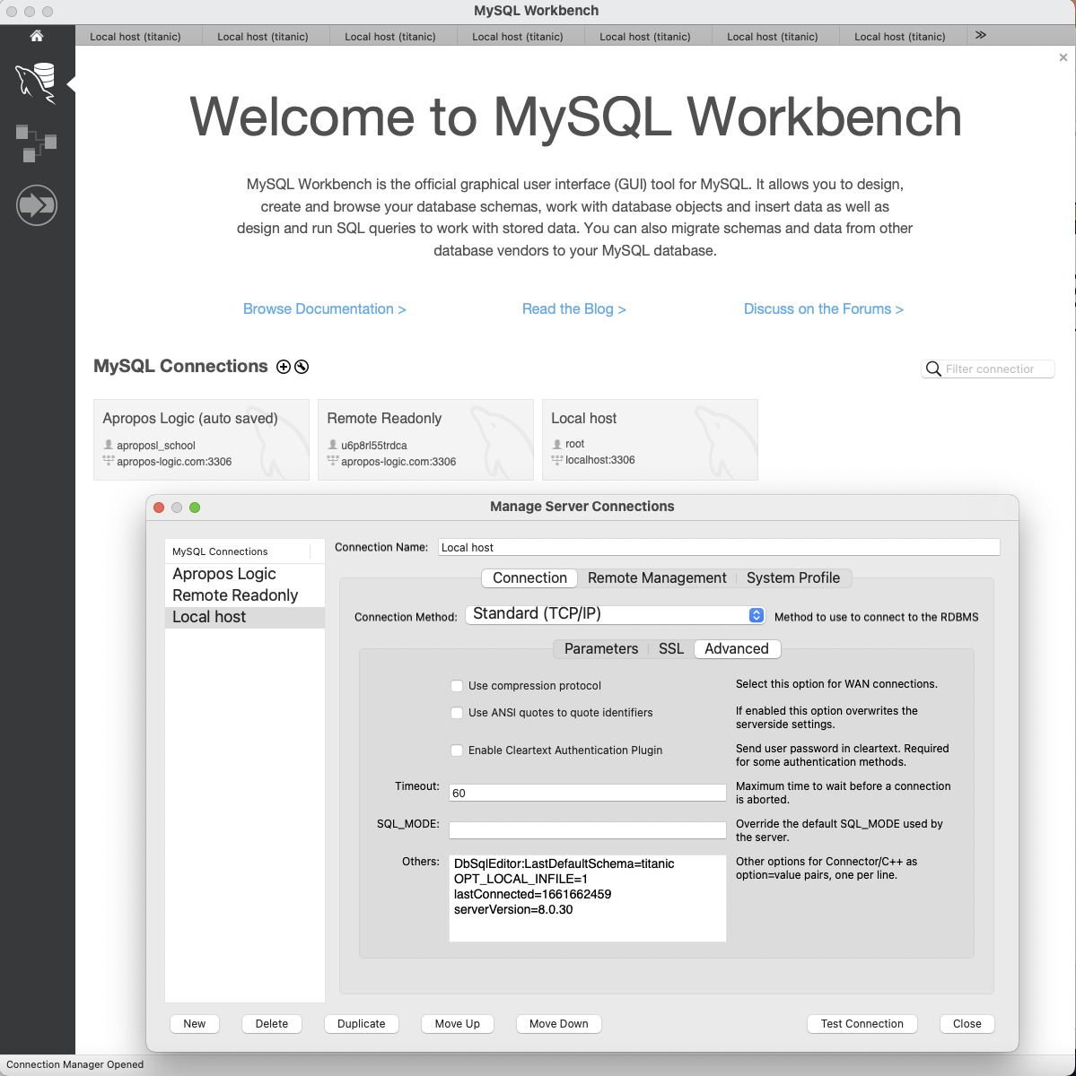
ETL CSV Data #2
Right-click to edit.
Select Advanced
Add OPT_LOCAL_INFILE=1

Slide 15
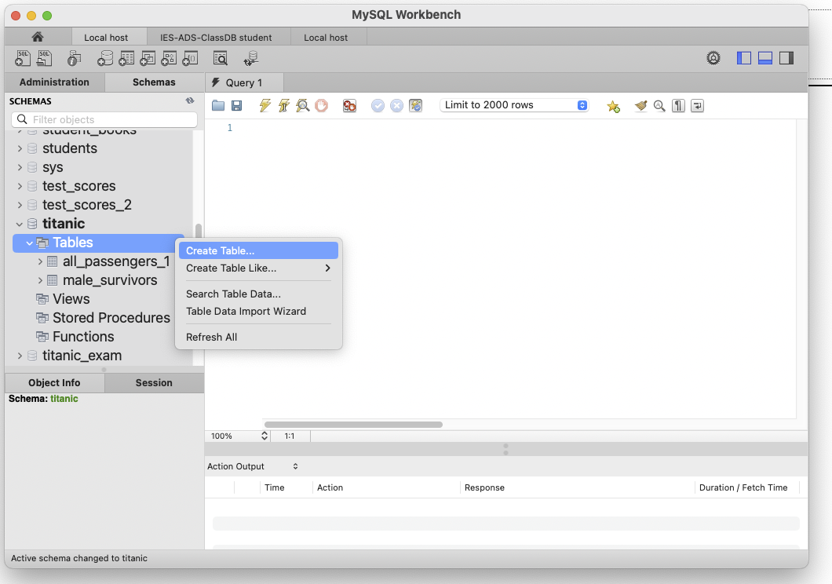
ETL CSV Data #2, cont’d

Slide 16
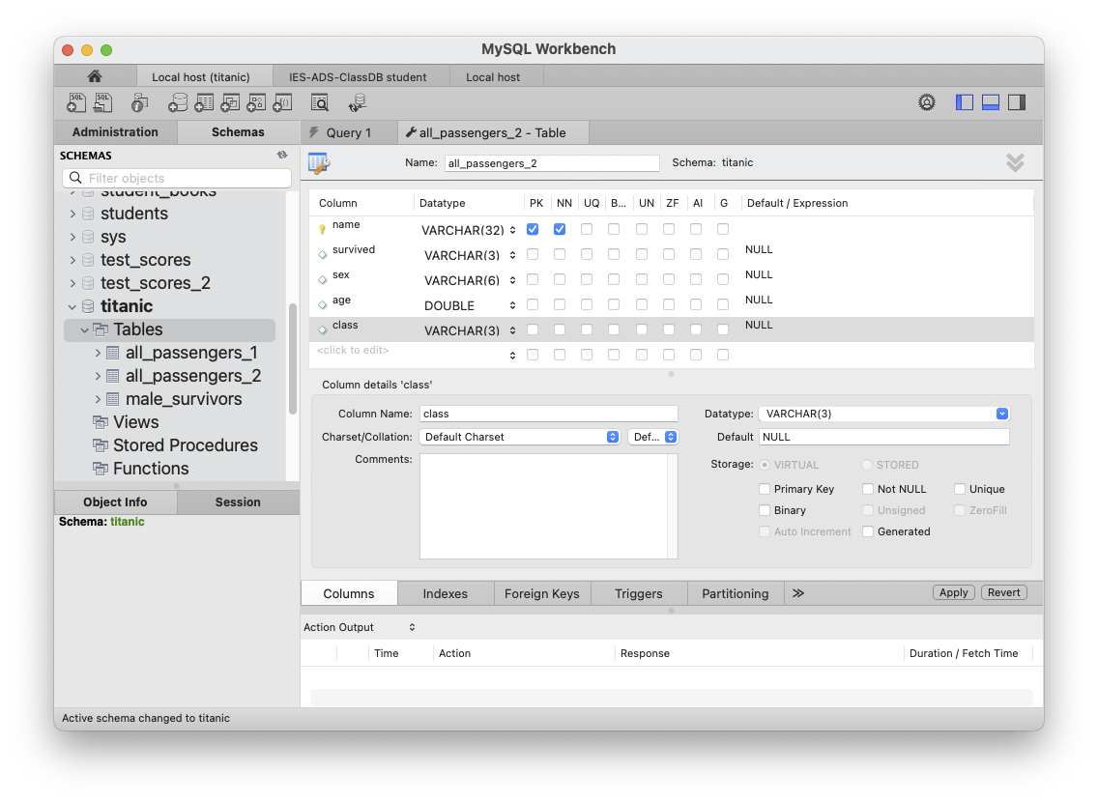
ETL CSV Data #2, cont’d

Slide 17
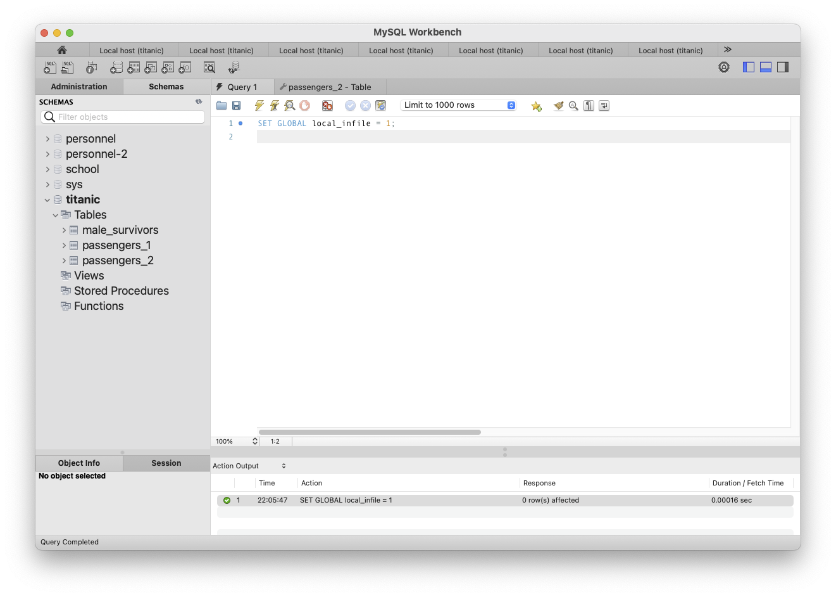
Load CSV Data #2, cont’d
SET GLOBAL local_infile = 1

Slide 18
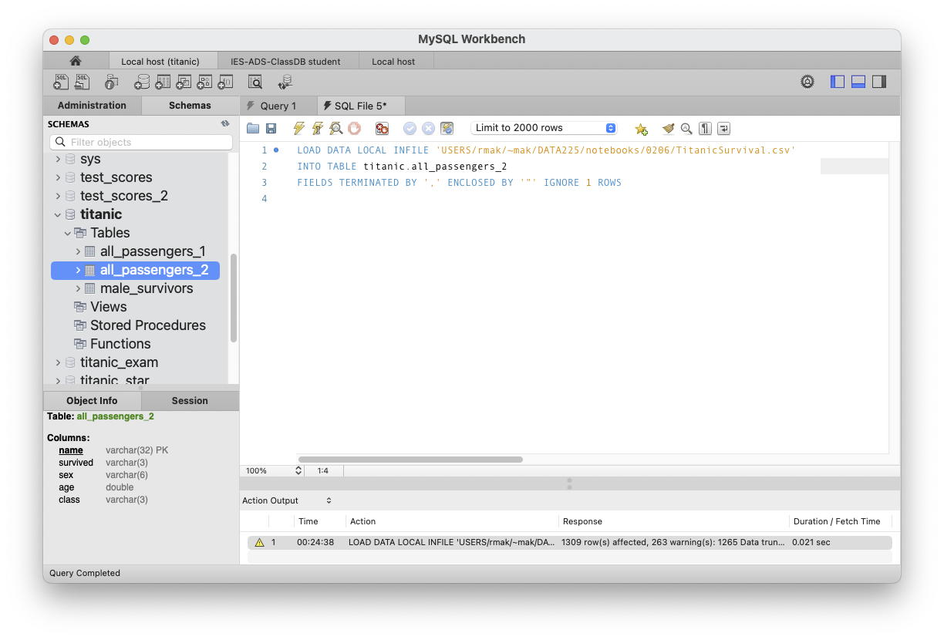
ETL CSV Data #2, cont’d
LOAD DATA LOCAL INFILE 'USERS/rmak/~mak/DATA225/notebooks/0828/TitanicSurvival.csv'
INTO TABLE titanic.all_passengers_2
FIELDS TERMINATED BY ',' ENCLOSED BY '"' IGNORE 1 ROWS
Because we declared field age to
have datatype double, the 263 rows
with NA for age had age set to 0.
Demo

Slide 19
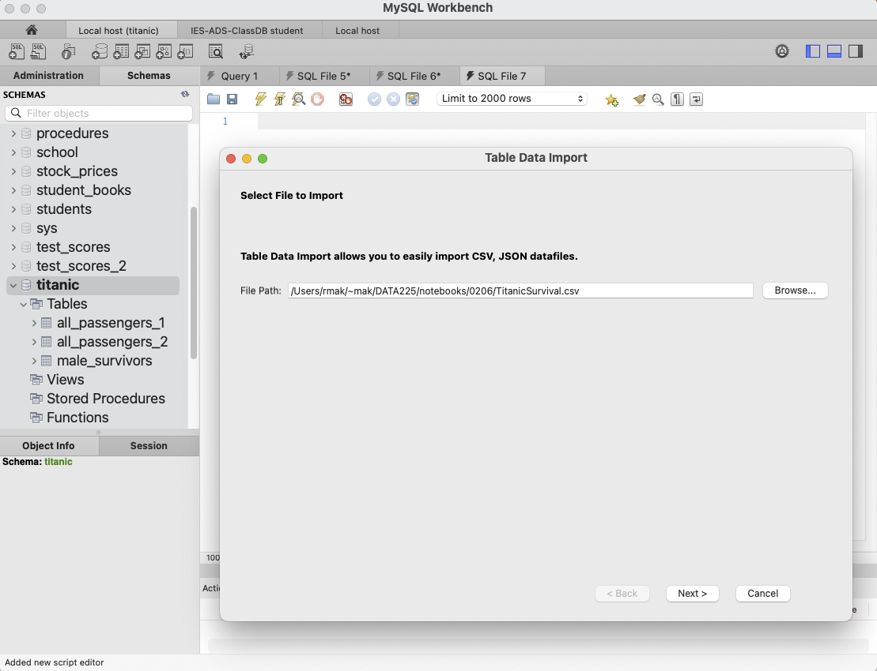
ETL CSV Data #3
Right-click titanic and select Table Data Import Wizard

Slide 20
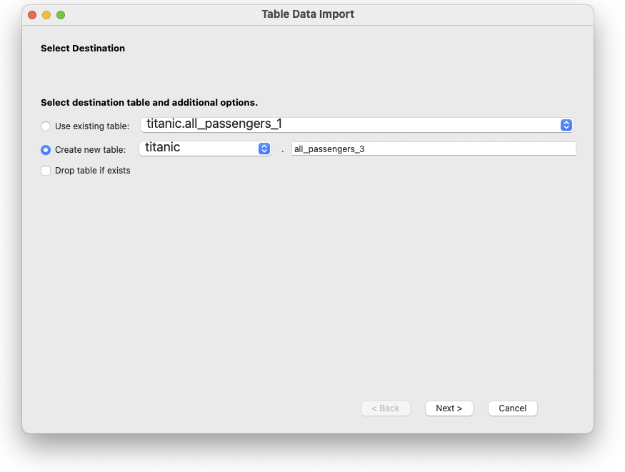
ETL CSV Data #3, cont’d

Slide 21
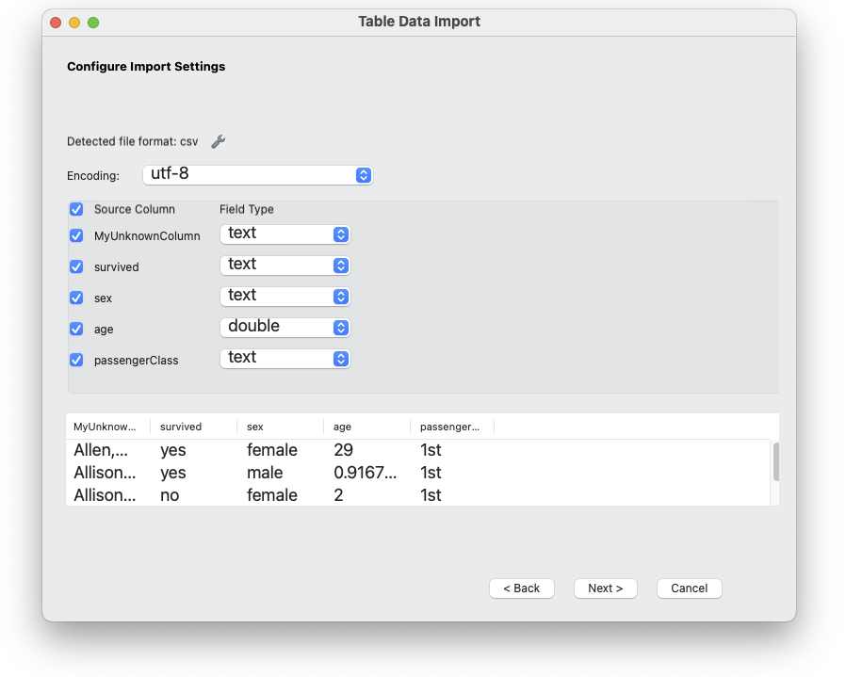
ETL CSV Data #3, cont’d

Slide 22
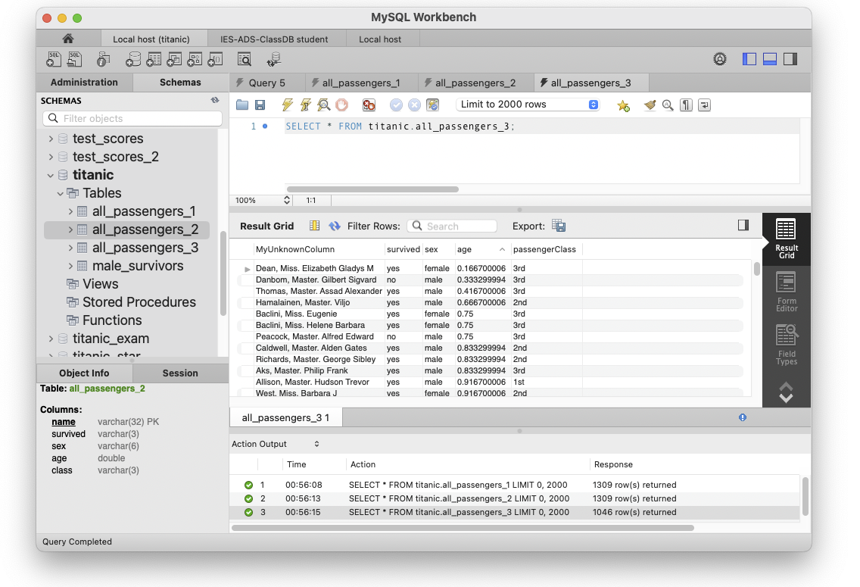
ETL CSV Data #3, cont’d
Apparently, the import wizard
silently skipped the rows where
age was NA.

Slide 23
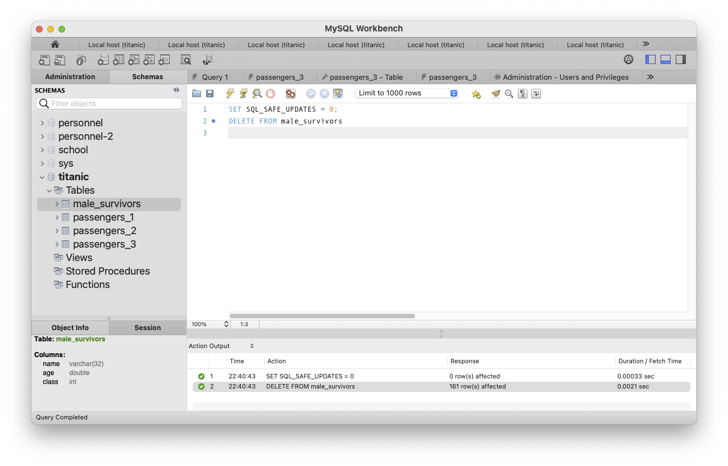
Delete Rows from a Table
SET SQL_SAFE_UPDATES = 0;
DELETE FROM male_survivors

Slide 24
Delete Rows from a Table, cont'd
You can delete only certain rows from a table:
SET SQL_SAFE_UPDATES = 0;
DELETE FROM all_passengers_2
WHERE age > 10

Slide 25
Delete Databases and Tables
The database world has its own vocabulary.
To delete (remove) a table:
To delete a database (AKA schema):
DROP TABLE employee
DROP TABLE IF EXISTS employee
DROP DATABASE school
DROP SCHEMA school
DROP DATABASE IF EXISTS school
DROP SCHEMA IF EXISTS school

Slide 26
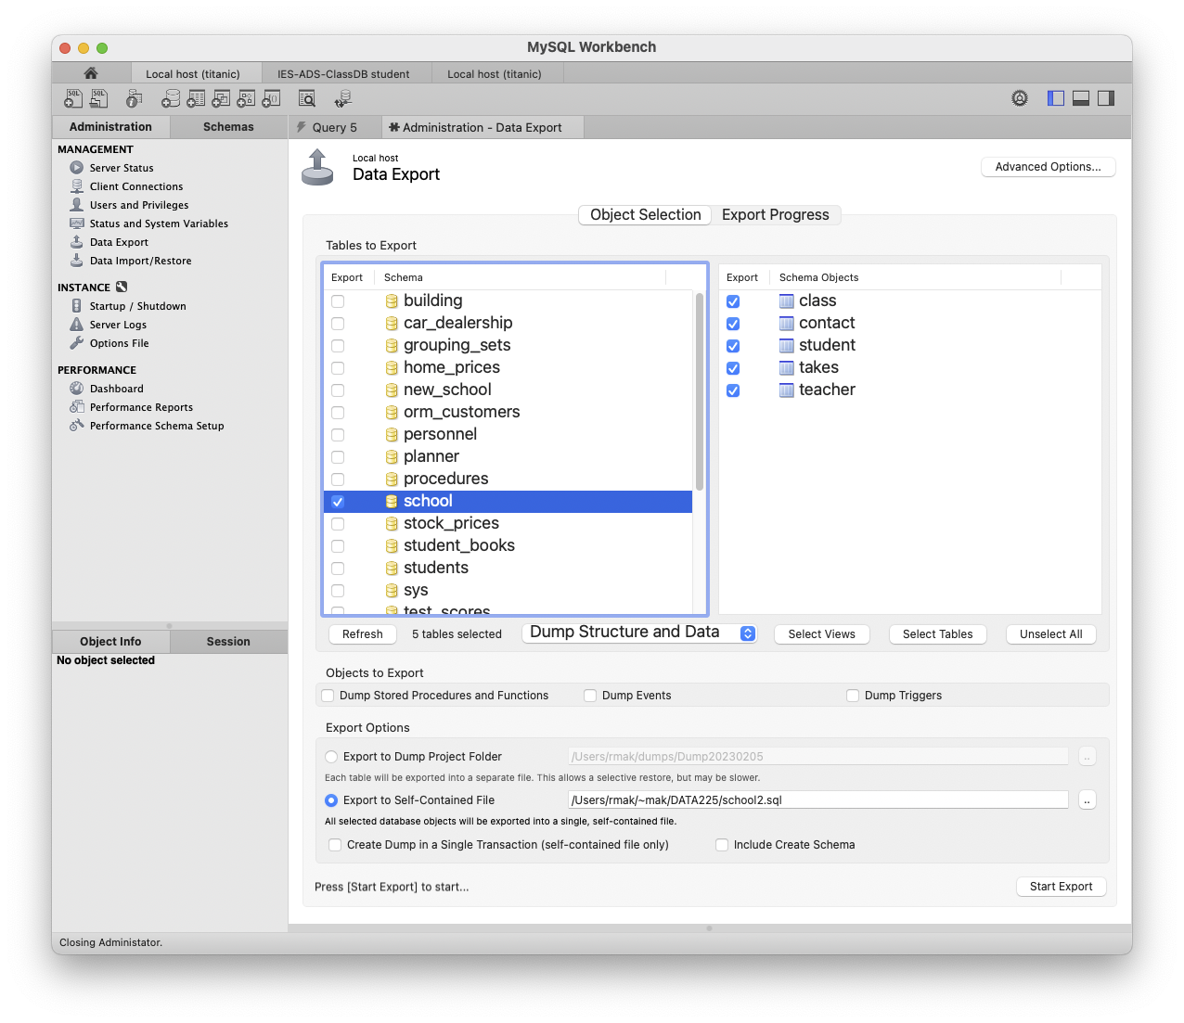
Export (Dump/Backup) a Database

Slide 27
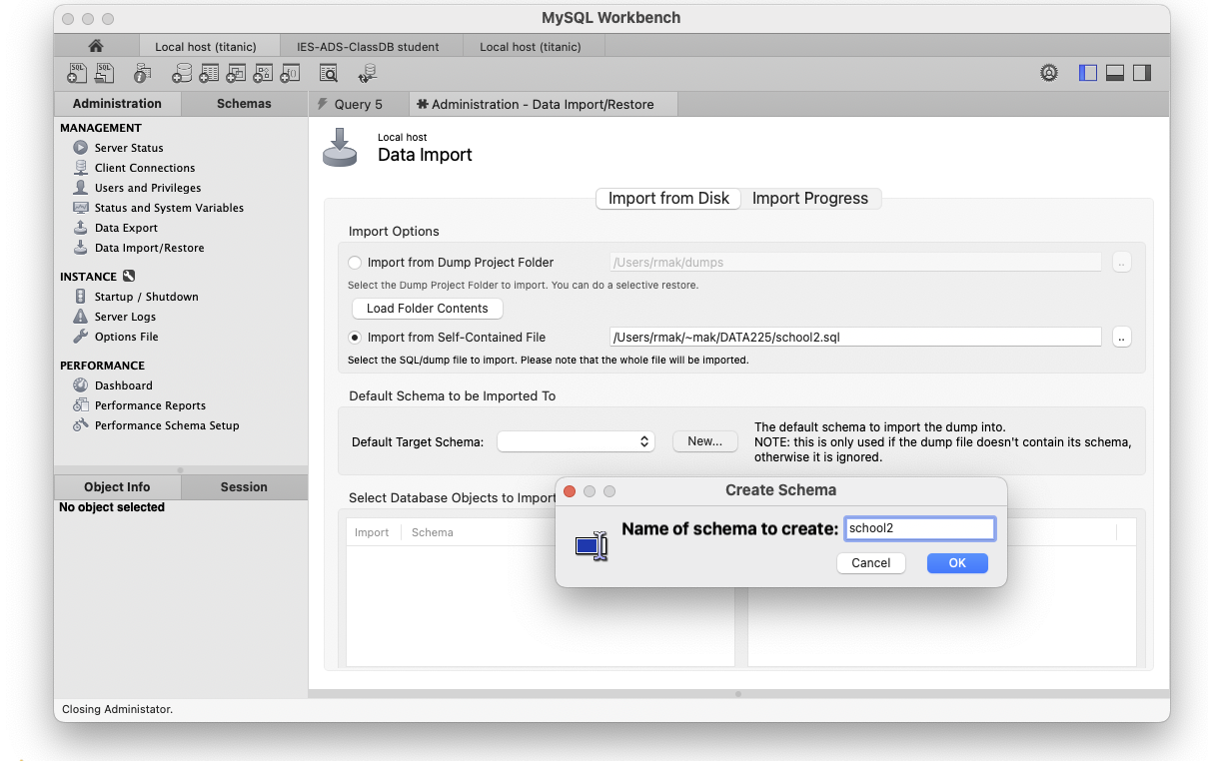
Import (Restore) a Database
This is how team members
can exchange databases.

Slide 28
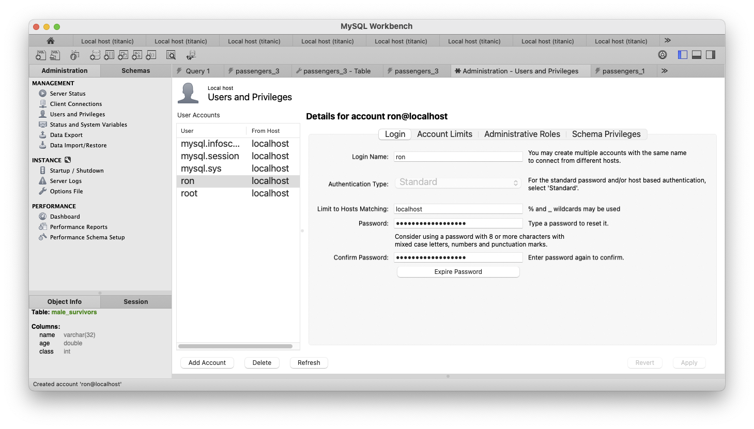
Create a User
You are creating a new user (account)
to the database server. Then you assign access privileges to individual databases.

Slide 29
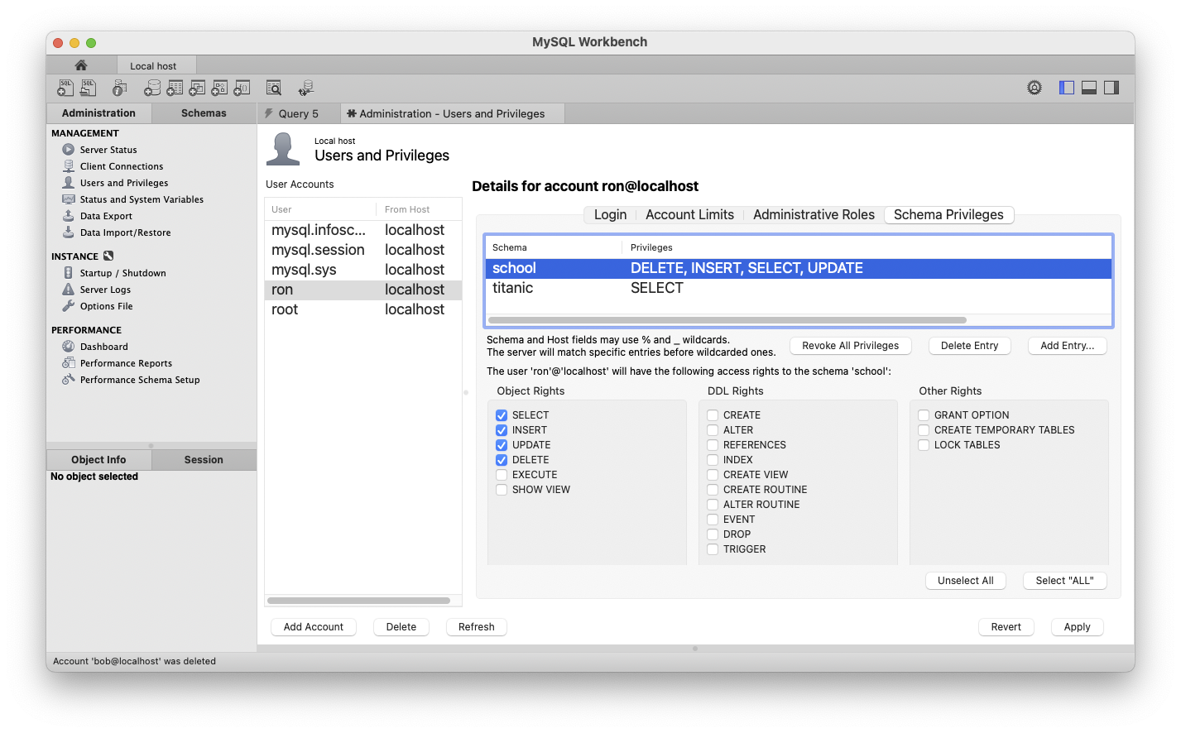
Create a User, cont’d

Slide 30
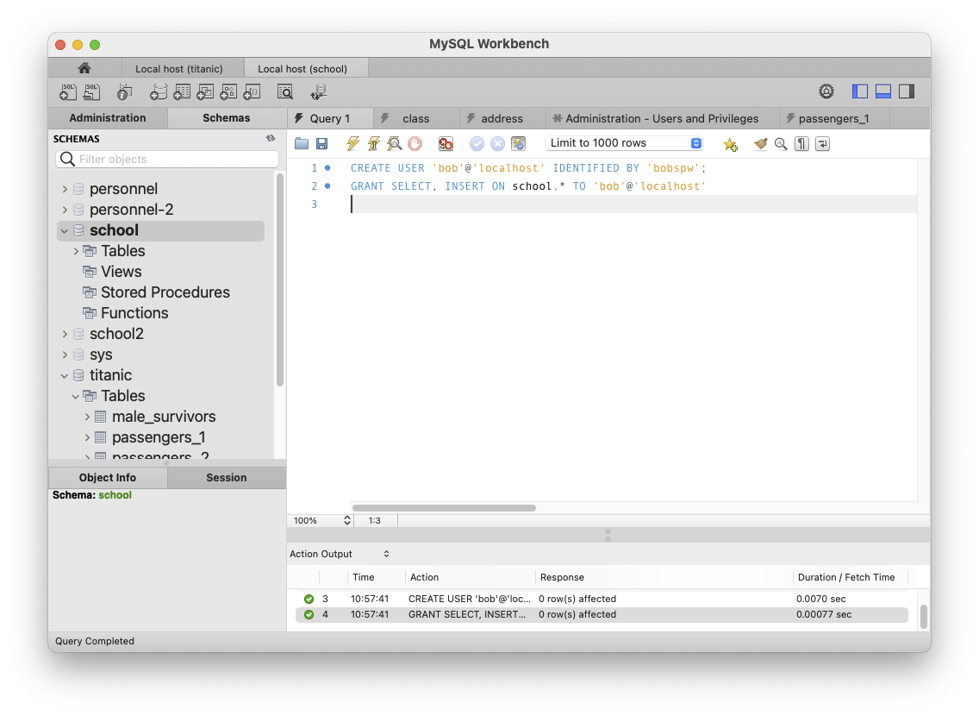
Create a User, cont’d
Create a user using SQL:
CREATE USER 'bob'@'localhost' IDENTIFIED BY 'bobspw';
GRANT SELECT, INSERT ON school.* TO 'bob'@'localhost'

Slide 31
The mysql Command in a Terminal Window
(base) ~/~mak/DATA225: mysql -u ron -p
Enter password:
Welcome to the MySQL monitor. Commands end with ; or \g.
Your MySQL connection id is 35
Server version: 8.0.30 MySQL Community Server - GPL
mysql> show databases;
+--------------------+
| Database |
+--------------------+
| information_schema |
| performance_schema |
| school |
| titanic |
+--------------------+
4 rows in set (0.00 sec)
mysql> use school
Database changed
mysql>
User ron can only see the
databases that he can access.

Slide 32
The mysql Command, cont’d
mysql> show tables;
+------------------+
| Tables_in_school |
+------------------+
| class |
| contact |
| student |
| takes |
| teacher |
+------------------+
mysql> SELECT first, last
-> FROM teacher, class
-> WHERE subject = 'Data Mining'
-> AND id = teacher_id;
+-------+------+
| first | last |
+-------+------+
| John | Lane |
+-------+------+
1 row in set (0.00 sec)
mysql>

Slide 33
The mysql Command, cont’d
To run the LOAD command:
mysql> SET GLOBAL local_infile = 1;
Query OK, 0 rows affected (0.00 sec)
mysql> use titanic
Database changed
mysql> LOAD DATA LOCAL INFILE 'TitanicSurvival.csv'
-> INTO TABLE titanic.all_passengers_2
-> FIELDS TERMINATED BY ',' ENCLOSED BY '"' IGNORE 1 ROWS;
Query OK, 1309 rows affected, 263 warnings (0.01 sec)
Records: 1309 Deleted: 0 Skipped: 0 Warnings: 263
mysql> quit
Bye
(base) ~/~mak/DATA225:

Slide 34
Break

Slide 35
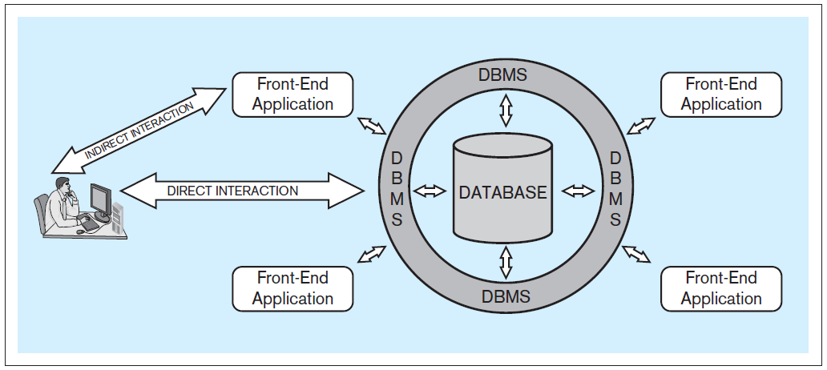
Database System Architecture
Database system: A computer-based system that enables efficient interaction between users and information stored in a database.
Database Systems
by Jukić, Vrbsky, & Nestorov
Pearson 2014
ISBN 978-0-13-257567-6

Slide 36
Client-Server Architecture
Local machine localhost
network
MySQL
database server
Python
database
application
"""
SELECT * FROM teacher
"""
Databases
results
"""
SELECT * FROM teacher
"""
Port 3306
MySQL
Workbench
"""
SELECT * FROM teacher
"""
results
results
Terminal
running
mysql
client app
"""
SELECT * FROM teacher
"""
Web apps
"""
SELECT * FROM teacher
"""
Web
Browser
Apache
web server
results
Remote machine
IES-ADS-ClassDB.sjsu.edu

Slide 37
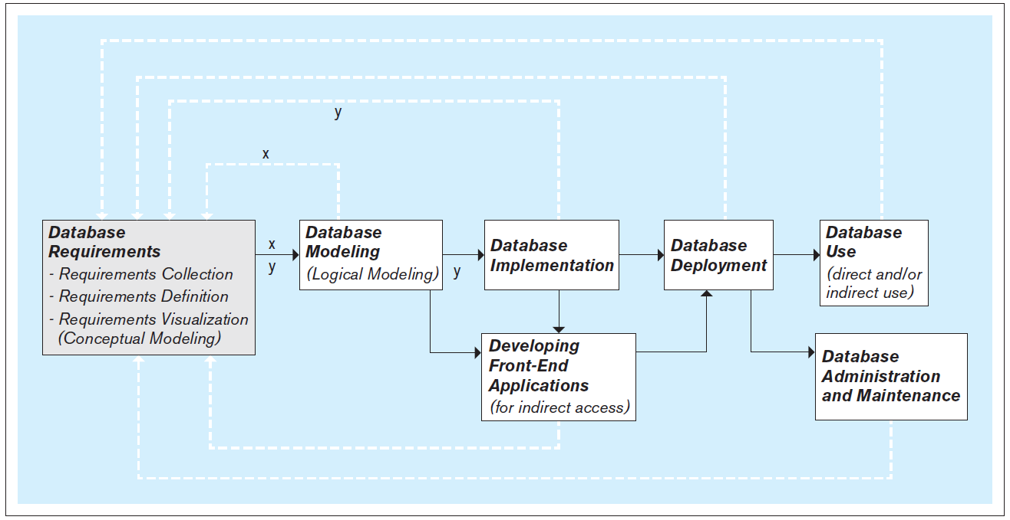
Steps to Develop a Database
It’s an iterative process!
Database Systems
by Jukić, Vrbsky, & Nestorov
Pearson 2014
ISBN 978-0-13-257567-6

Slide 38
Database Requirements
First and most critical step: Collect, define, and visualize the requirements.
What data will the database hold and how?
What will be the capabilities and functionalities of the database?
Reliability, performance, and security issues?
Use the requirements to model and implement the database and to create the front-end applications.

Slide 39
Conceptual Database Model
Visualize the requirements.
Build a conceptual data model.
Example: Entity-relationship (ER) modeling
Draw ER diagrams.
Implementation independent: No dependencies on the logic of a particular database management system.
Example DBMS: Oracle, IBM, MySQL, etc.
Blueprint for the logical model.

Slide 40
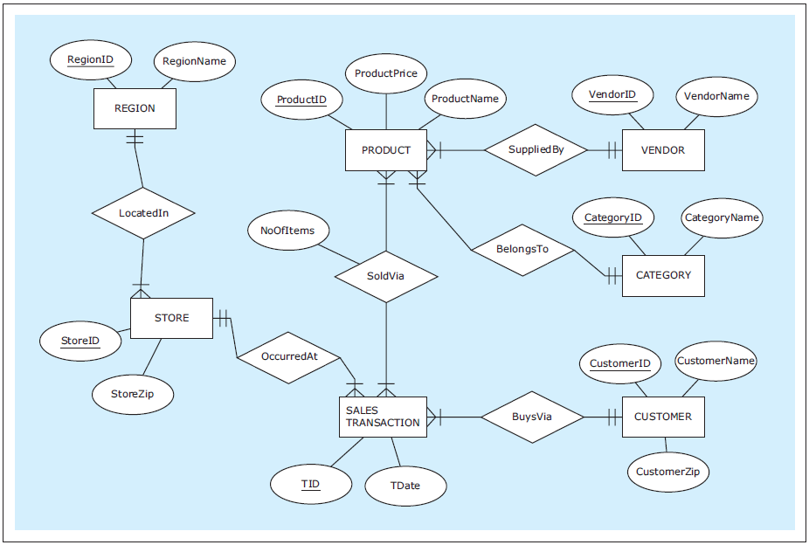
Example Conceptual Model: ER Diagram
Draw ER diagrams using the free tool at https://erdplus.com
Database Systems
by Jukić, Vrbsky, & Nestorov
Pearson 2014
ISBN 978-0-13-257567-6

Slide 41
Logical Database Model
Create the relational logical database model.
Later: Non-relational NoSQL models.
It’s usually straightforward to map an ER diagram to a relational model.

Slide 42
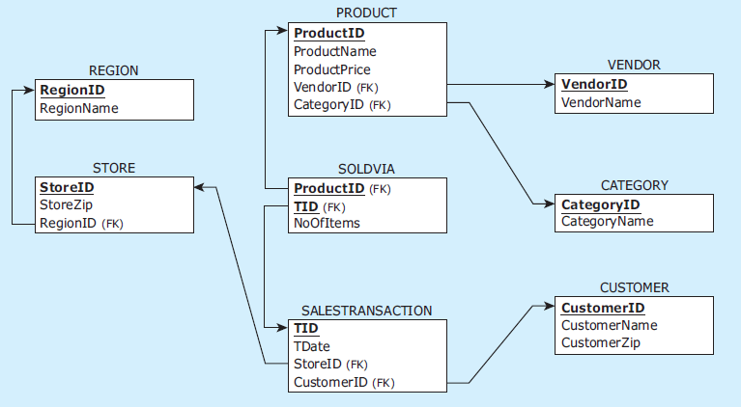
Example Logical Model: Map ER Diagrams to Tables
Database Systems
by Jukić, Vrbsky, & Nestorov
Pearson 2014
ISBN 978-0-13-257567-6

Slide 43
Physical Database Model
The physical model is the actual database implementation.
Use relational DBMS (RDBMS) software.
Later: NoSQL systems
SQL commands to create, delete, modify, and query database structures.

Slide 44
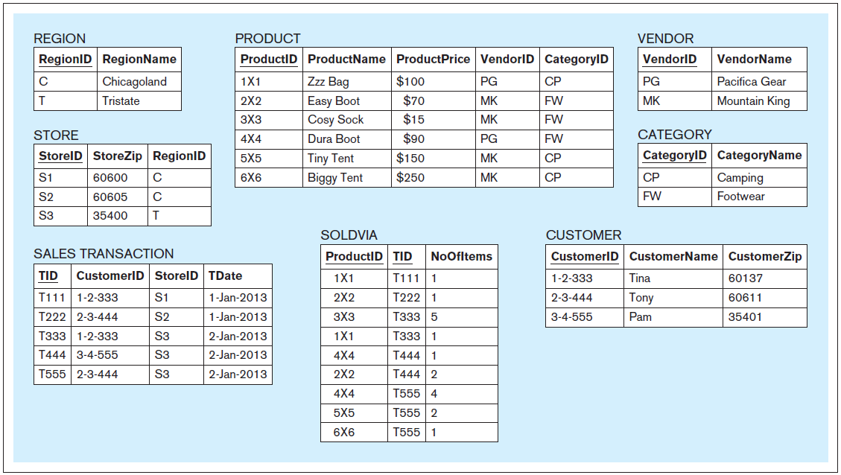
Example Physical Model
Database Systems
by Jukić, Vrbsky, & Nestorov
Pearson 2014
ISBN 978-0-13-257567-6

Slide 45
Front-End Application Development
End users generally do not access the database directly.
Front-end applications
Access the database directly.
Provide end users with safe application-oriented interfaces to query and manipulate the data.
Fulfill the end user’s requirements.

Slide 46
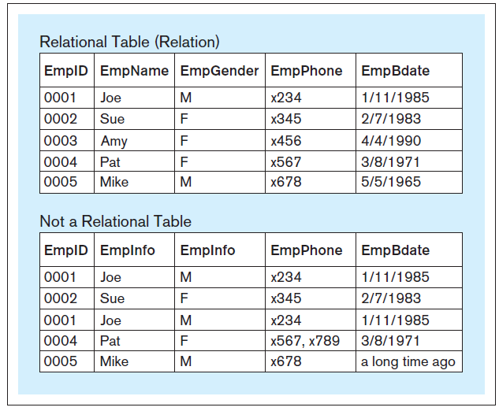
Table Structure in a Relational Database
Within a table of a relational database:
Each column must have a unique name.
All the values in each column must have the same datatype (e.g., all integers, all text, etc.)
Each row must be unique.
Within each row, each value in each column must be single-valued.
Row order and column order are irrelevant.
X
A table in a relational database
is also called a “relation”.
Database Systems
by Jukić, Vrbsky, & Nestorov
Pearson 2014
ISBN 978-0-13-257567-6

Slide 47
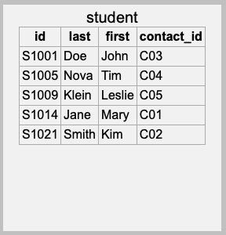
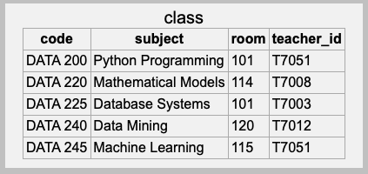
Primary Key
Each table must have a primary key.
A column or set of columns whose value uniquely identifies each row.
Primary key
Primary key

Slide 48
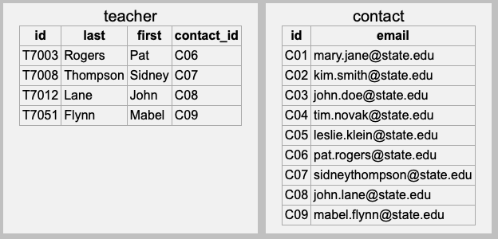
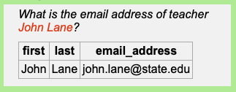
Foreign Keys
A table can have one or more columns of foreign keys that each refers to another table.
A foreign key value is equal to the primary key value of a row in the other table.
This is how the database
solves an address query!
Foreign key
Primary key

Slide 49
One-to-One (1:1) Relationship
This is known as a one-to-one relationship.
Also written 1:1.
One row of the first table relates to one row of the second table.
Foreign key
Primary key

Slide 50
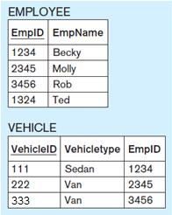
One-to-One Relationship, cont’d
In a 1:1 relationship, either table can have the foreign key to the other table.
A table can have multiple foreign key columns that each relates to a different other table.
Table VEHICLE
has the foreign key.
Molly has Van 222.
Database Systems
by Jukić, Vrbsky, & Nestorov
Pearson 2014
ISBN 978-0-13-257567-6

Slide 51
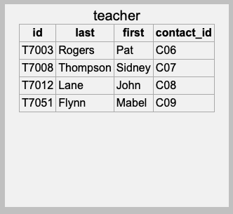
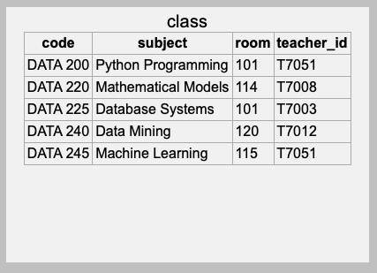
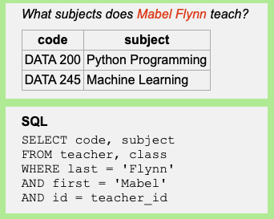
One-to-Many (1:M) Relationship
In a one-to-many relationship, one row of a table can be related to many rows of another table.
Here, “many” means “zero, one, or more”.
Foreign key
One teacher can teach
many classes.

Slide 52
One-to-Many (1:M) Relationship, cont’d
In a one-to-many relationship, the foreign key must be in the table on the “many” side.
In the example below, why can’t the teacher table
contain the foreign key to the class table?
Foreign key
One teacher can teach
many classes.

Slide 53
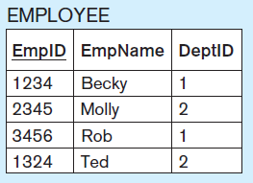
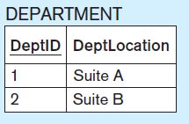
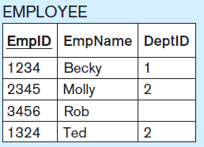
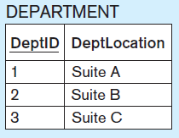
One-to-Many (1:M) Relationship, cont’d
Each department (1) can have
many employees (M).
Optional participation on the 1 side.
Rob does not belong to any department.
Optional participation on the M side.
(Can you see it?)
Department 3 has no employees.

Slide 54
Many-to-Many (M:N) Relationship
In a many-to-many relationship, one row of the first table can be related to many rows of the second table. Conversely, one row of the second table can be related to many rows of the first table.
Remember that “many” means “zero, one, or more”.
Our example school database allows one student (from the student table) to take many classes (from the class table). Also, one class can be taken by many students.

Slide 55
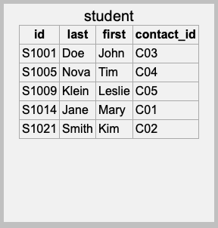
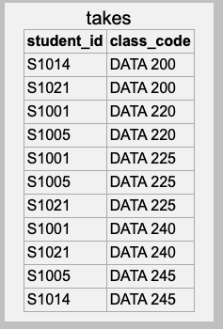
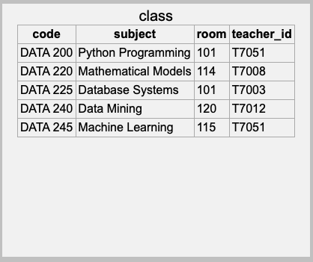
Many-to-Many (M:N) Relationship, cont’d
A M:N relationship requires an intermediary linking table.
The linking table has two foreign key columns, one for each table of the relationship.
The two foreign key columns
of the linking table together also
constitute the linking table’s
primary key.
Linking table

Slide 56
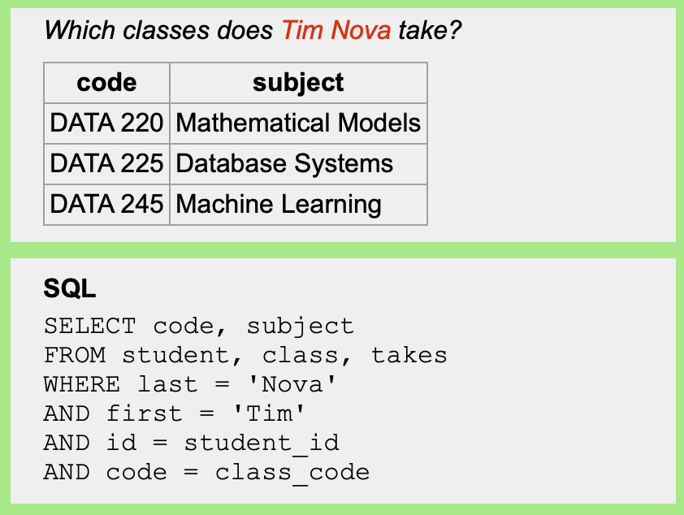
Many-to-Many (M:N) Relationship, cont’d
One student takes
many classes.

Slide 57
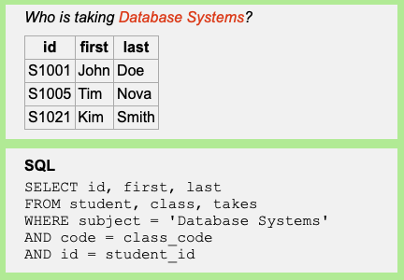
Many-to-Many (M:N) Relationship, cont’d
One class is taken
by many students.

Slide 58
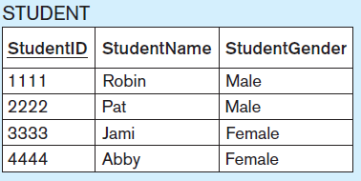
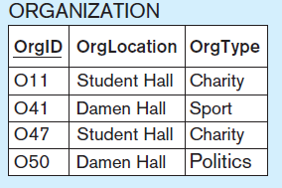
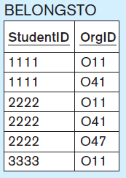
Many-to-Many (M:N) Relationship, cont’d
To which organizations
does each student belong?
Robin belongs to
O11/Student Hall/Charity and
to O41/Damen Hall/Sport.
Linking table
Who belongs to each
organization?
O11/Student Hall/Charity
has Robin, Pat, and
Jami belonging to it.
Optional participation on both sides.
Abby does not belong to any organization.
O50/Damen Hall/Politics has no student members.

Slide 59
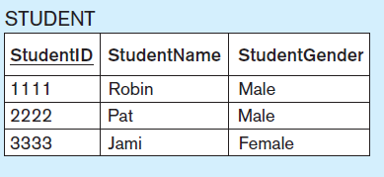
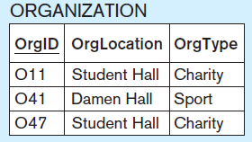
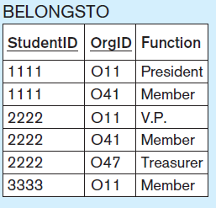
Many-to-Many (M:N) Relationship, cont’d
Relationship with an attribute.
Column BELONGSTO.Function
Robin belongs to O11/Student Hall/Charity as its President
and to O41/Damen Hall/Sport as a Member.
O41/Student Hall/Charity has Robin belonging to it as its President,
Pat as its V.P., and Jami as a Member.

Slide 60
Assignment #2
Design and create database tables.
ETL from CSV files.
Perform queries.
Team assignment

Slide 62
